Slide 1
IST 210 Organization of Data SQL Penn State Abington
Dr. S. Gokhan Ozden
gokhan@psu.edu

Slide 2
SELECT and WHERE
The SELECT statement allows to select columns from the table
WHERE clause is used to filter data rows

Slide 3
SQL Query Window
Click SQL Workshop
Click SQL Commands

Slide 4
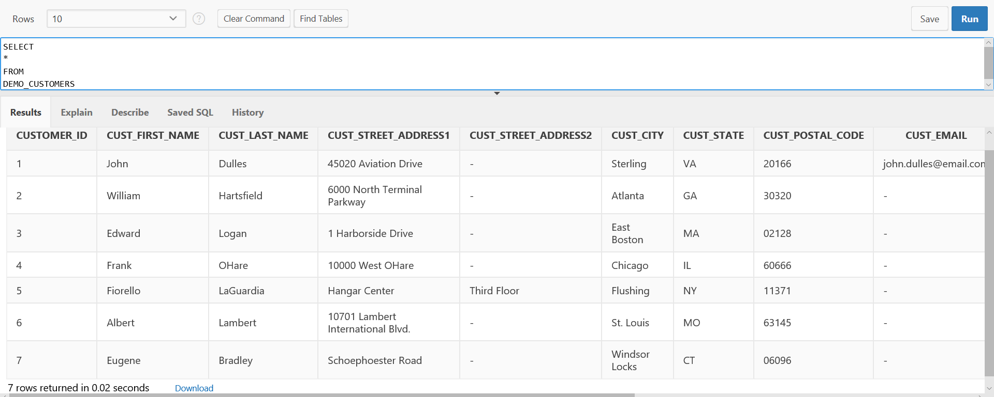
SELECT
‘*’ Allows you to select all columns in Demo_Customers table

Slide 5
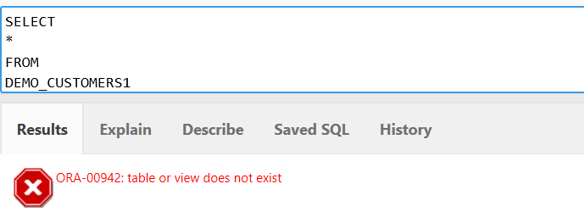
When There is an Error
There is no DEMO_CUSTOMERS1 table!
And if you execute the SQL, you'll get an error in the Results tab
It says the table or view does not exist.
IST210
Organization of Data
5

Slide 6
Exercise 1
List Customer ID, Customer First Name, Phone Number for Customers
Here I am not naming any specific column names
You need to make your best guess by looking at the Demo_Customers table

Slide 7
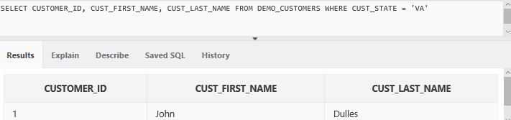
SELECT and WHERE
Table Name
Attribute List
Filter (Where Clause)
Result Set
String values are enclosed in single quotes and they are not case-sensitive

Slide 8
SELECT and WHERE
We can also use other operators in the WHERE clause like =, <=, >=, <>
<> means not equals
<= means less than or equal to
>=means greater than or equal to

Slide 9
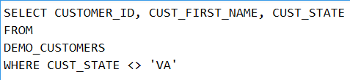
SELECT and WHERE
<> operator
List Customer ID, Customer First Name, State for Customers who don't live in VA.

Slide 10
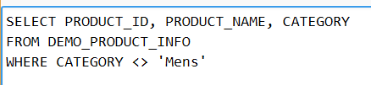
Exercise 2
List Product ID, Product Name, Category Name for Products which does not belong to Mens

Slide 11
Exercise 3
Write a SQL query that returns all Orders that are ordered after 20 July 2017
SELECT * FROM DEMO_ORDERS WHERE ORDER_TIMESTAMP > '20-JUL-17'

Slide 12
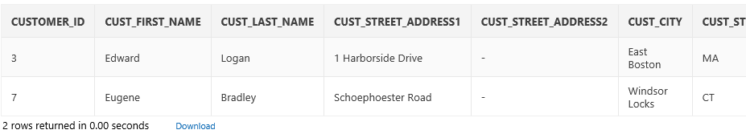
SELECT and WHERE
Customer Name Starting with E
Use LIKE when using %
% matches anything (which includes nothing at all)
SELECT * FROM Customers
WHERE CUST_FIRST_NAME LIKE 'E%'
Select only the customer whose Customer First Name begins with E
IST210
Organization of Data
12

Slide 13
SELECT and WHERE
Customer First Name With E Anywhere (case sensitive)
Anything (%) followed by a E followed by anything (%)
% can be used more than once
Anything inside the single quotes is case sensitive
SELECT * FROM Customers
WHERE CUST_FIRST_NAME LIKE '%E%'
Select only the customer whose Customer First Name having E anywhere
IST210
Organization of Data
13

Slide 14
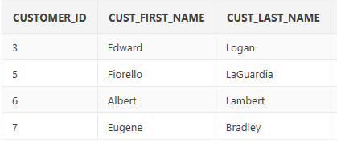
SELECT and WHERE
Customer First Name With E Anywhere (case in-sensitive)
UPPER function converts everything inside into upper case
UPPER function needs to be used on the right side for correct comparison
SELECT * FROM Customers
WHERE UPPER(CUST_FIRST_NAME) LIKE UPPER('%E%')
IST210
Organization of Data
14

Slide 15
Exercise 4
Write a SQL statement that shows customers whose state begins with a letter M
Modify that statement to only show the first name and the state.

Slide 16
Aliasing
Aliasing allows you to specify different names for your tables and columns
Table Aliasing – SELECT C.CUST_CITY FROM DEMO_CUSTOMERS C
‘as’ keyword is not necessary
This saves time while typing
We will see the benefit of table aliasing when we do joins using multiple tables
Column Aliasing –
In this case it is double quotes
SELECT CUST_CITY AS "Customer City" FROM DEMO_CUSTOMERS

Slide 17
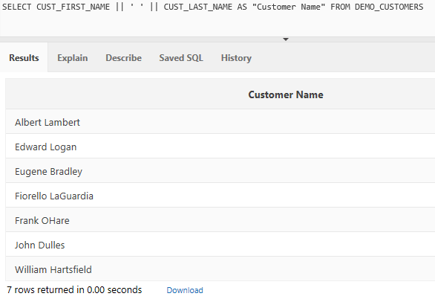
Concat Operator (||)
Concat operator helps to combine values of two or more columns into one column in the result
First Name and Last Name columns are combined into one
We added a space between first and last name
Then we named concatenated new column as Customer Name

Slide 18
Exercise 5
List Customer ID, Customer Name, Customer Full Address for Customers who don't live in MA.
Use your best guess to find the customer name parts and address parts from the table
Use alias names wherever I have specified

Slide 19
More Operators
AND
OR
IS NULL
IS NOT NULL
Ranges (between numbers or strings)
IN (checking if a value is in a list)
EXISTS
NOT EXISTS

Slide 20
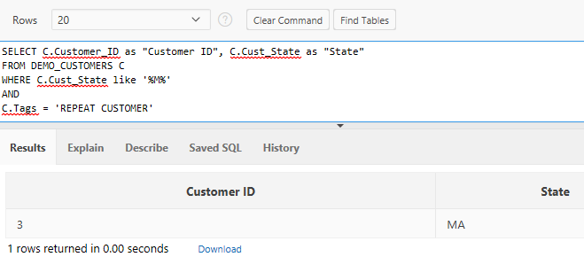
AND Operator
Expression using the LIKE operator
Can be combined with any other expression
Expression using the = operator

Slide 21
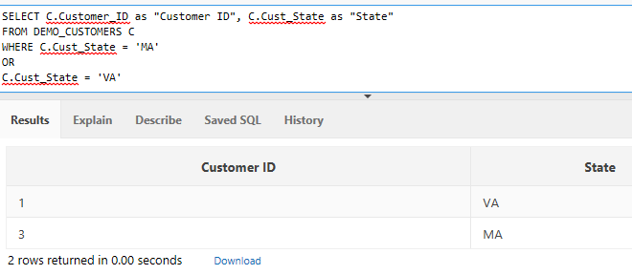
OR Operator

Slide 22
Combining AND with OR
AND’s have higher priority than OR’s
Truth table can help you solve the
A | B | A AND B
0 | 0 | 0
0 | 1 | 0
1 | 0 | 0
1 | 1 | 1
A | B | A OR B
0 | 0 | 0
0 | 1 | 1
1 | 0 | 1
1 | 1 | 1

Slide 23
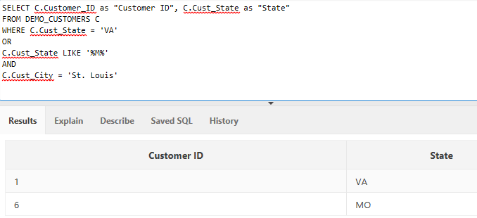
Combining AND with OR
AND has higher precedence so AND is evaluated first and then the result is ORed
Result contains cities other than St. Louis

Slide 24
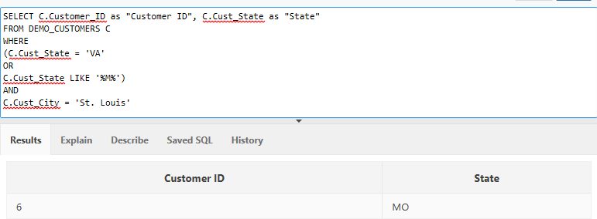
Combining AND with OR
Use of parentheses can solve this problem
Use of parentheses fixes the problem as Boolean expression contained within it evaluated first

Slide 25
Exercise 6
List Customer ID, Customer Name, City, State for Customers who either live in ‘Atlanta' or ‘Chicago' and who is a repeat customer.

Slide 26
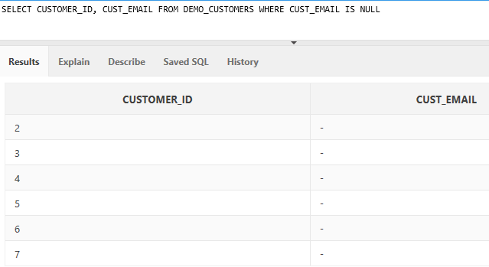
IS NULL
NULL means nothing or not defined
It doesn’t mean 0 or empty string
‘IS NULL’ is the keyword to search for NULL values
NULL values are stored as ‘NULL’ and it may be shown as dashed values

Slide 27
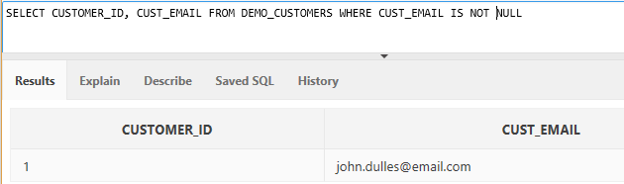
IS NOT NULL
No CUST_EMAIL which have NULL as value is returned

Slide 28
Exercise 7
Write a SELECT that has Customers fields
Customer ID
Customer Full Name
Customer Full Address
Customer E-mail
With these conditions
The customer is a repeated customer
The e-mail is NULL

Slide 29
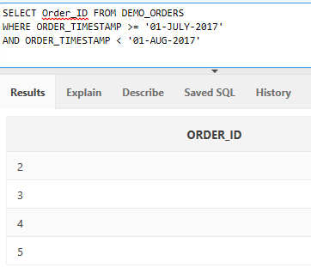
Date Ranges
SQL lets you find fields within a range
All orders placed in July 2017
>= means greater-than or equal-to

Slide 30
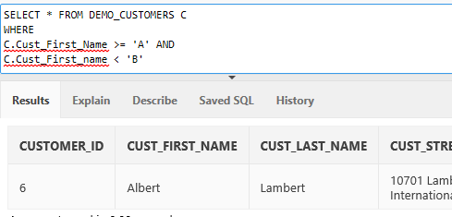
String Ranges
A customer first name beginning with A
SELECT
C.Customer_ID
C.Cust_First_Name
FROM Demo_Customers C
WHERE
C.Cust_First_Name >= 'A' AND
C.Cust_First_Name < 'B'
NOTE That's the same as C.Cust_First_Name LIKE 'A%'

Slide 31
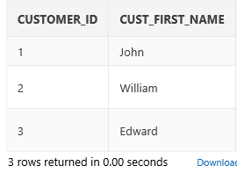
Checking For Different Values
Looking for a list of certain customers
Use OR to add each condition
SELECT
C.Customer_ID,
C.Cust_First_Name
FROM Demo_Customers C
WHERE
(
C.Customer_ID = 1 OR
C.Customer_ID = 2 OR
C.Customer_ID = 3
)
There's an easier way to do that

Slide 32
The IN Condition
Looking for a list of certain customers
Use the IN condition
SELECT
C.CustomerID
C.Cust_First_Name
FROM Demo_Customers AS C
WHERE
C.Customer_ID IN (1, 2, 3)

Slide 33
Exercise 8
List all Customers who live in
VA
MA
MO

Slide 34
Exercise 9
List
Product ID,
Product Name,
List Price
For all Products which have List Price between 100 and 150

Slide 35
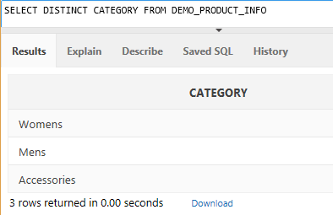
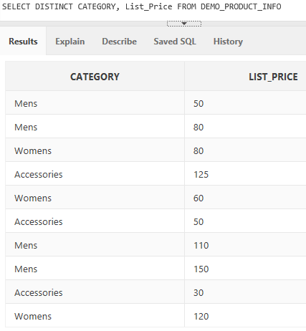
DISTINCT
Need for selecting distinct rows specified in the SELECT clause
Here it selects distinct Category and List Price
Here it select distinct Category

Slide 36
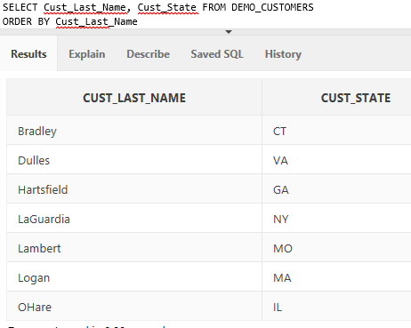
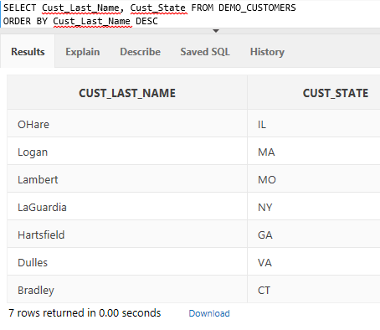
ORDER BY
ORDER BY is used to order the result in ascending or descending order
It defaults to ascending if no ASC or DESC specified
Here LastName is DESC specified
ASC – ascending
DESC- descending

Slide 37
Data Type
CHAR and VARCHAR
CHAR is a fixed length data type
Used to store non-Unicode (ASCII 0-127) characters
Occupies 1 byte of space for each character
If the value provided to a variable of CHAR data type is shorter than the length of a column of declared the size of the variable, then the value would be right-padded with blanks to match the size of column length.
VARCHAR is a variable length data type
NCHAR and NVARCHAR
NCHAR is a fixed length data type
Used to store Unicode (2²¹) characters
Occupies 2 byte of space for each character
If the value provided to a variable of NCHAR data type is shorter than the length of a column of declared the size of the variable, then the value would be right-padded with blanks to match the size of column length.
NVARCHAR is a variable length data type

Slide 38
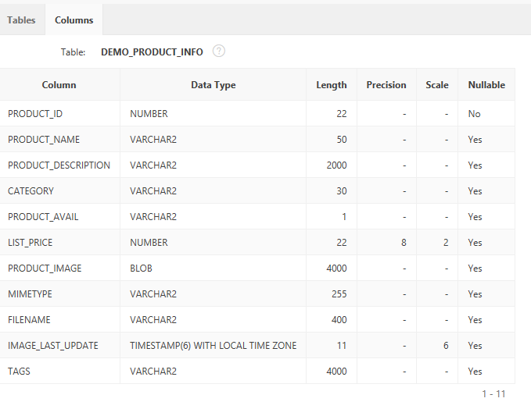
Nullable Data Type
If a data type of a attribute or column is Nullable, it can store NULL as value in the database
NULL means that there is no value or unknown or not applicable
NULL is not the same as Empty String
Ex: Here there are Null and Not Null columns in the table definition. Product_ID is Not Nullable.

